Slide 1

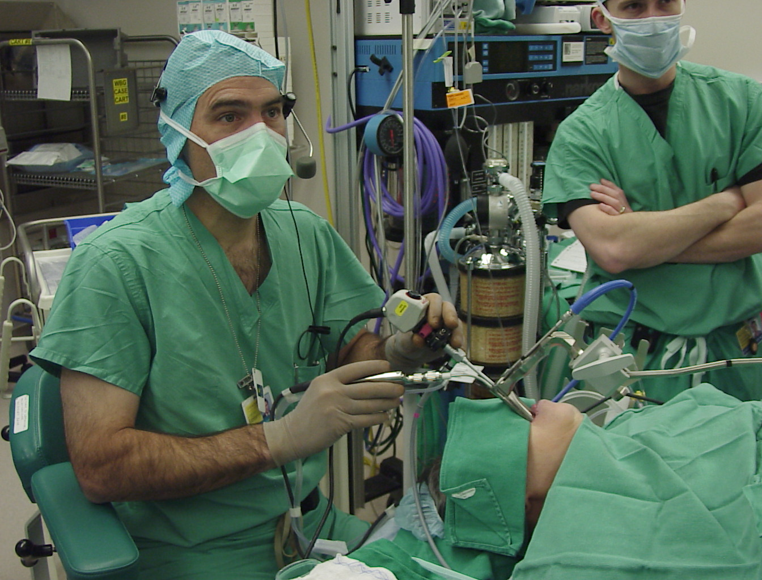
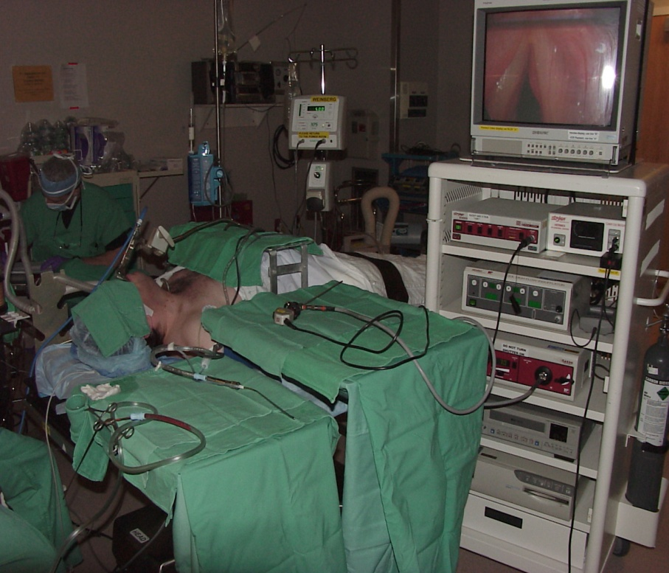
Minimally Invasive Surgery of the Throat*
endoscope
instrument
(tissue shaver)
laryngoscope
(cannula for instruments)
Constrained motion + rigid tools = No suturing or functional tissue reconstruction capability ➔
Our Goal: enable precise functional reconstruction of tissue inside the airways
*Images courtesy of Paul Flint M.D. Johns Hopkins School of Medicine

Slide 2
Distal Dexterity & Deep Surgical Fields
Single natural opening
2 unconstrained DoF
Deep surgical field
Min 4 DoF of Distal Dexterity enhancement is required with one being rotation about longitudinal axis of the gripper

Slide 3



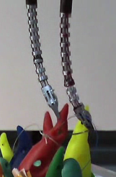
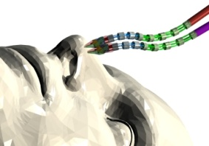
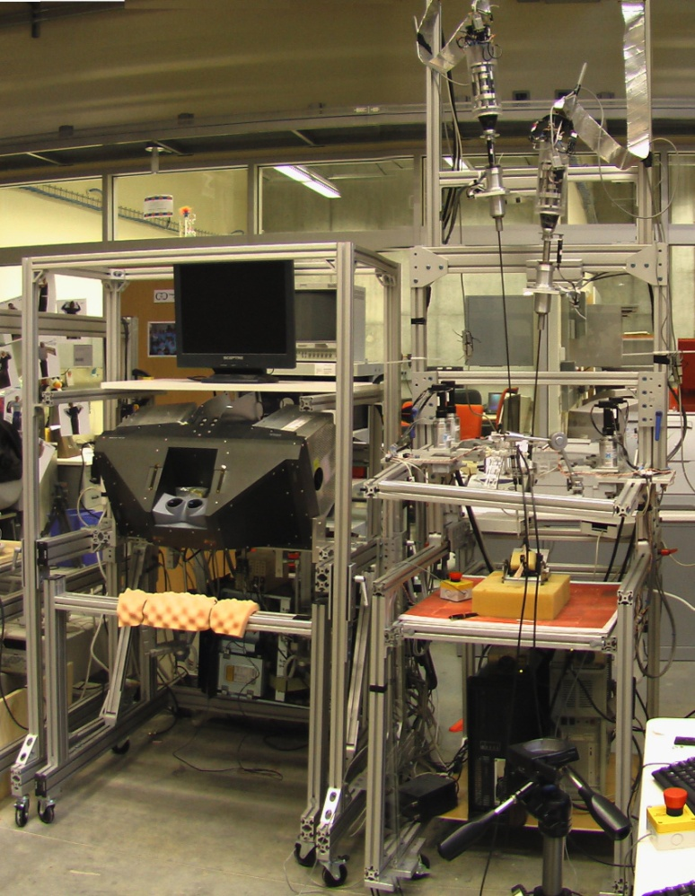
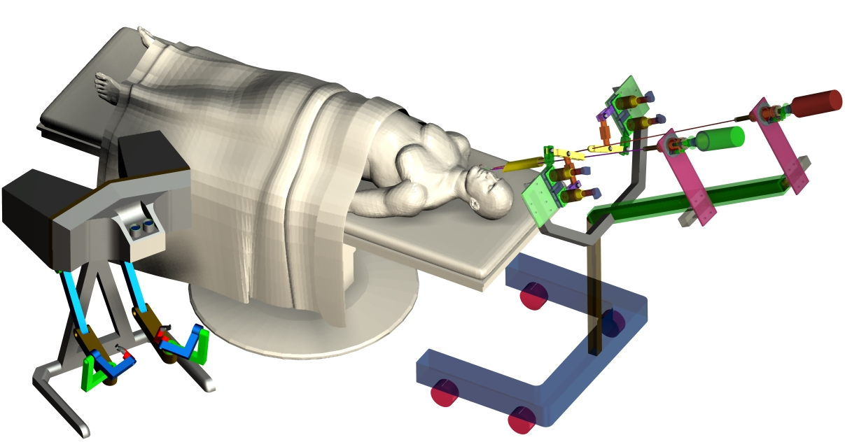

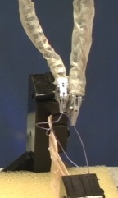
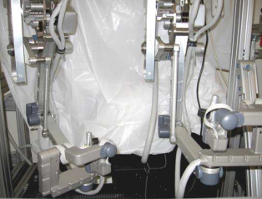
MIS of the Throat and Upper Airways
Ankur Kapoor telemanipulation
Laryngoscope with Integrated Stereo Vision
Left
slave
arm
Right slave
arm
2D display
3D display
Stereo Video Processing Unit
Local Area Network (LAN)
Left master arm
Left master arm
Right master arm
Left
slave arm
Right
slave arm
Right master arm
In collaboration with Russell H. Taylor ERC-CISST, JHU

Slide 4


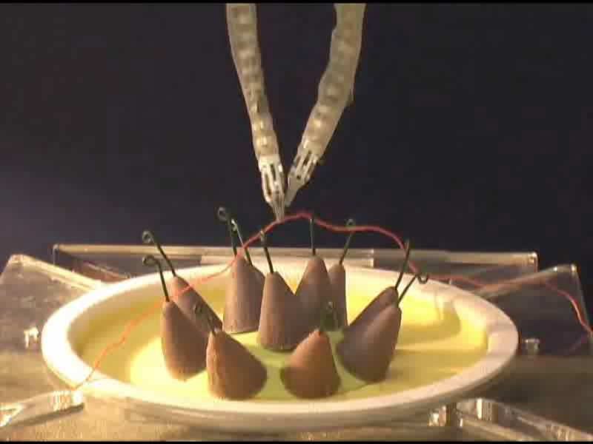
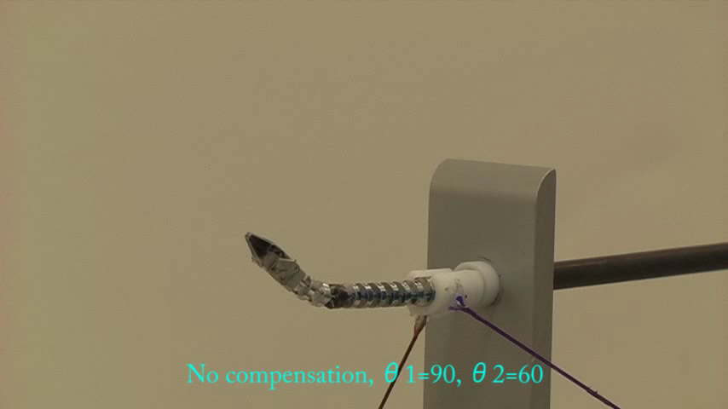
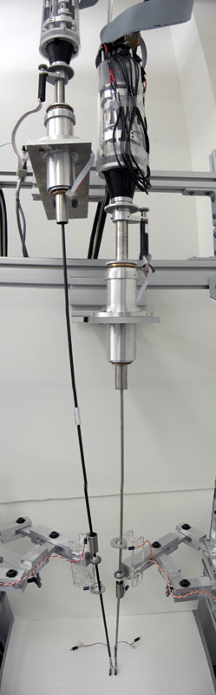
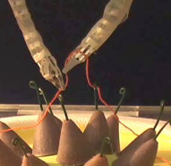
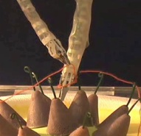
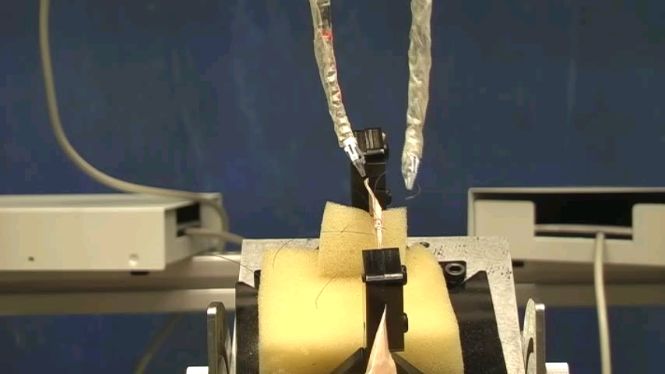
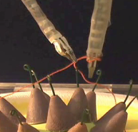
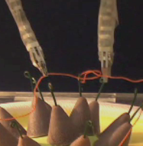
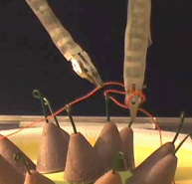
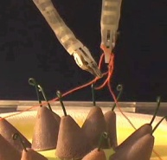
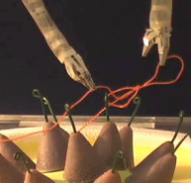
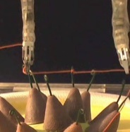
A system for MIS of the Throat
In collaboration with Ankur Kapoor and Russell Taylor JHU ERC-CISST

Slide 5
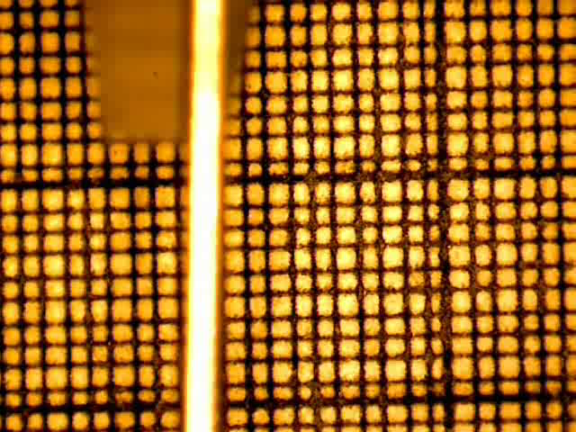
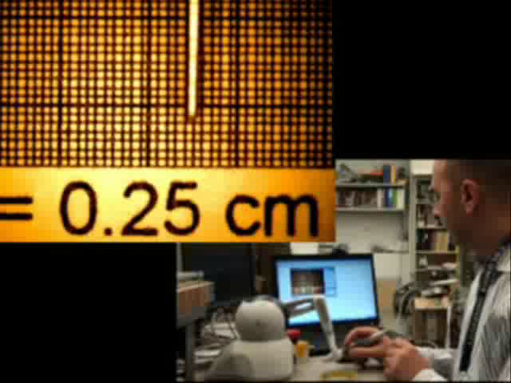
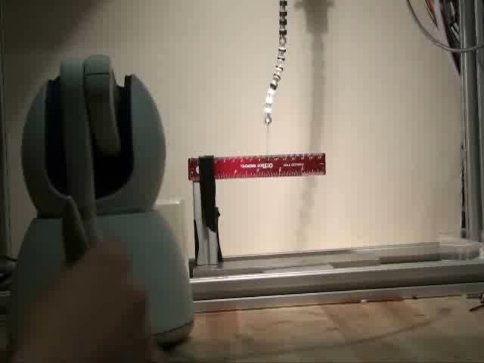
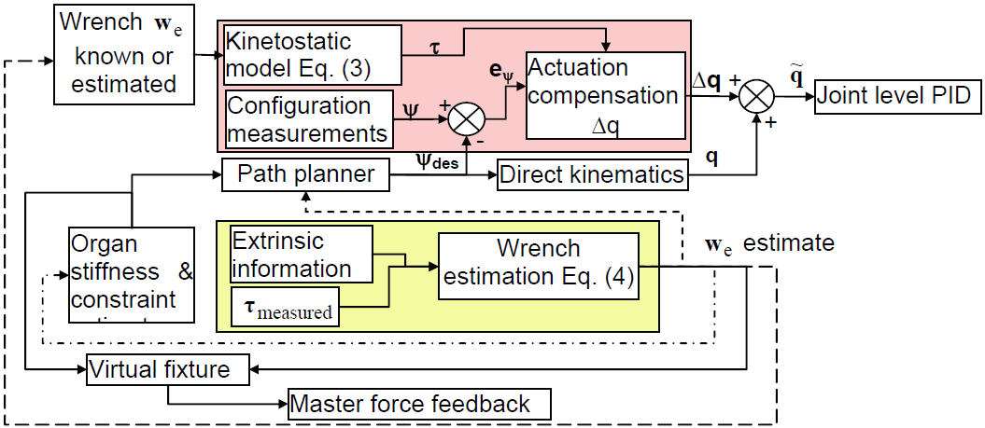
Control & Modeling Challenges for µ-surgery
250 μm

Slide 6
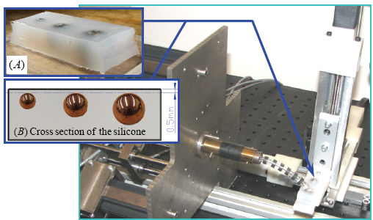
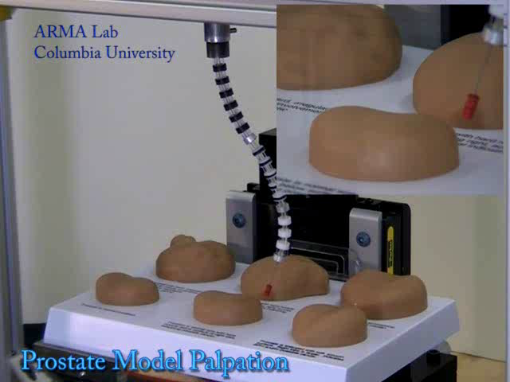
Examples of Palpating, Localizing “tumors” and Building Stiffness Maps
Exploratory manipulation
Estimation of wrenches at unknown location
Bracing /Whole arm manipulation
Multi-point Contact

Slide 7
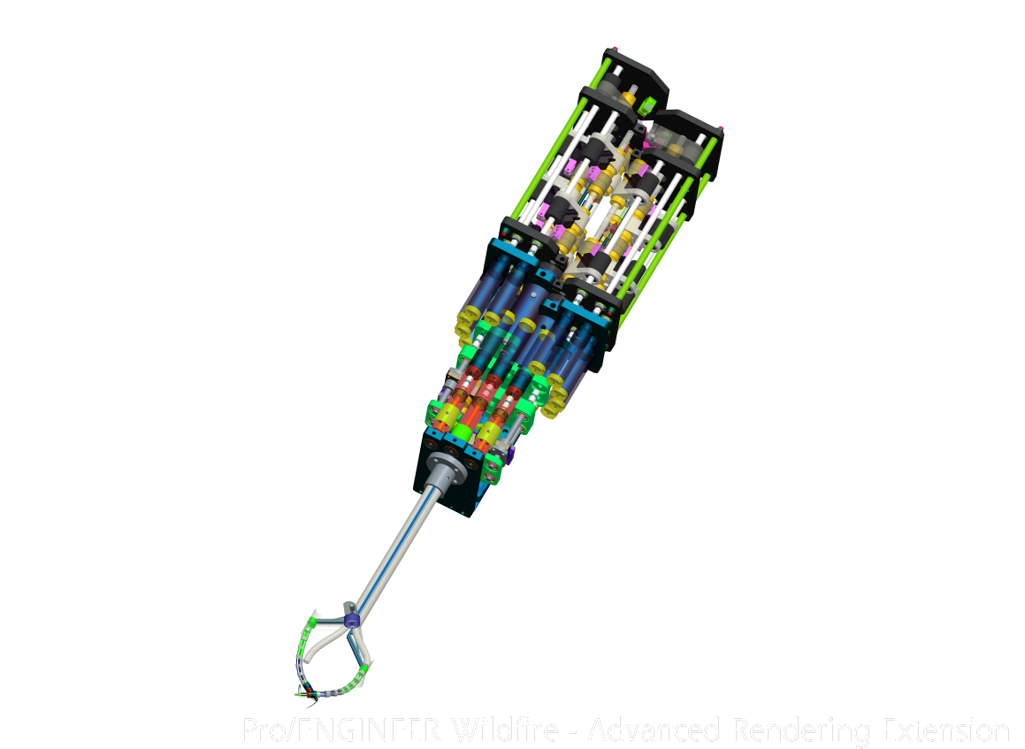
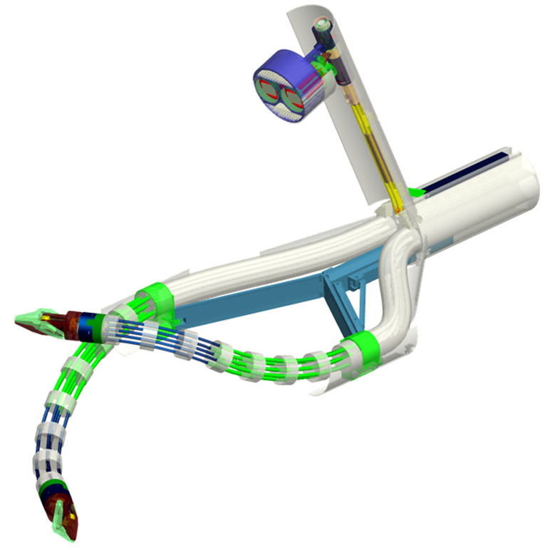
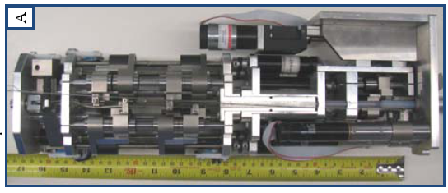
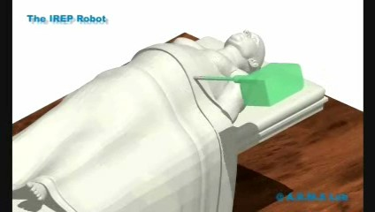

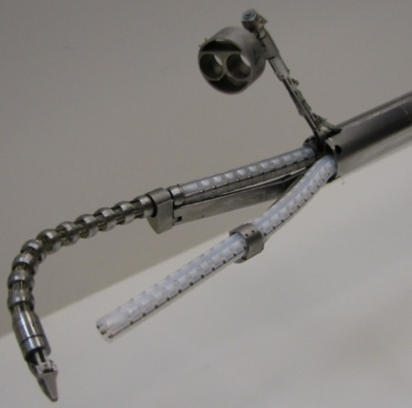
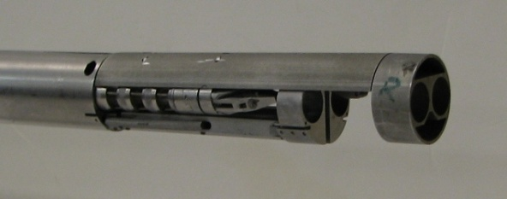
In-Vivo Sensory-Aided SPA Surgery
Three-DOF actuation for vision module
Stereo vision module with integrated light source
Optic fiber bundles
Central Stem
Parallelogram mechanism
2nd segment
Flexible stem
1st segment
Four-DOF continuum snake arm
One-DOF wrist
Forward-looking vision module
Gripper
Ø15mm
In collaboration with P. Allen C.S. Dept. & Dennis Fowler Columbia Medical School

Slide 8

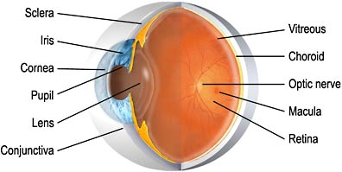
μ-Surgery of the EYE
Dual-Arm Orbital
Manipulation and Intraocular Dexterity

Slide 9
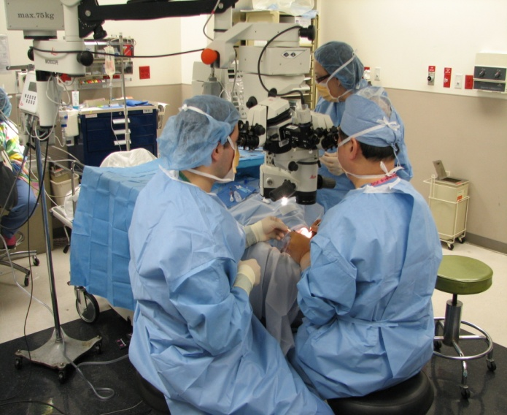
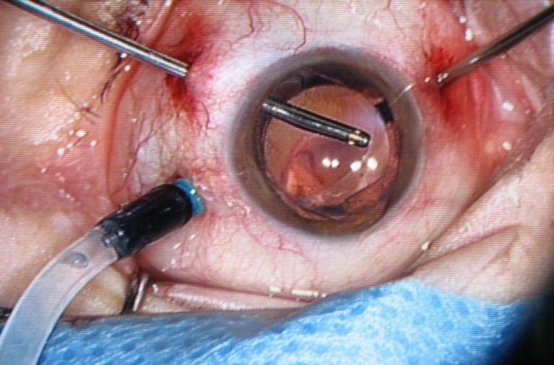
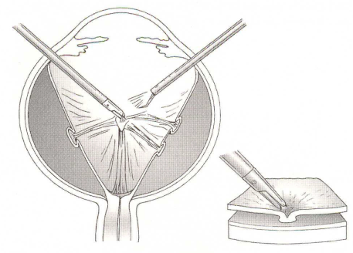
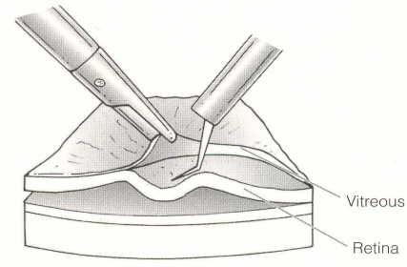
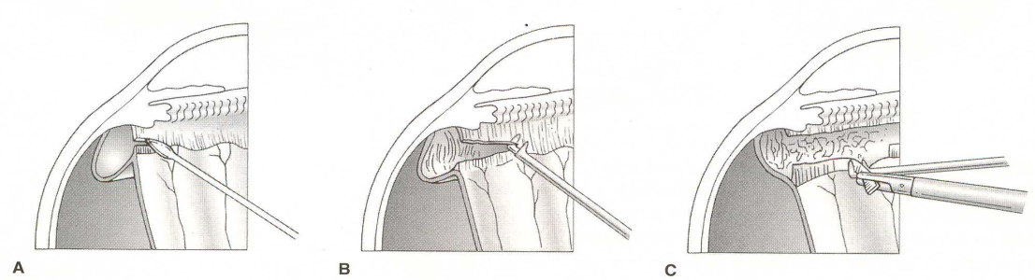
Ophthalmic Surgery
(A)
(B)
Microscope
Light Source
Surgical Tool
Assistant Surgeon
Irrigation Tube
Cornea
Main Surgeon
Patient
3 incisions / Multiple tools (laser, graspers, picks, light source)
Requires orbital manipulation
Requires precise intra-ocular dexterity
Dual arm operation
Vitreous membranes
Membrane peeling
Anterior vitreous membranes

