Slide 1
Example: Human Precision V.S. Robot-Assisted Precision
manual
robotic

Slide 2
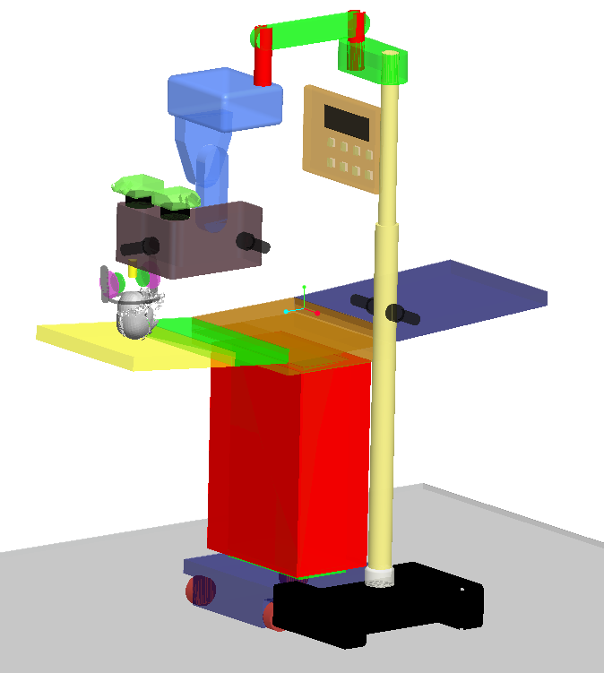
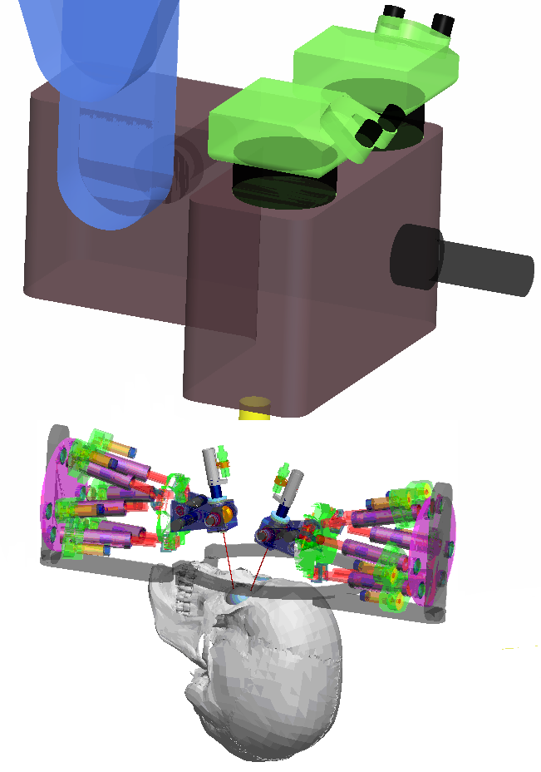
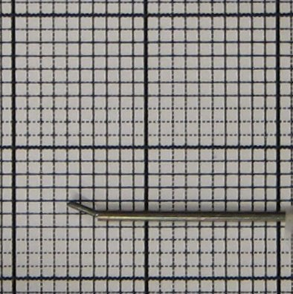
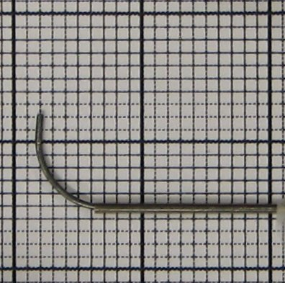
Dual Arm Ocular & Intraocular Dexterity
Bending tip
IODR cannula
We address the need for intraocular dexterity and orbital stabilization/ manipulation

Slide 3
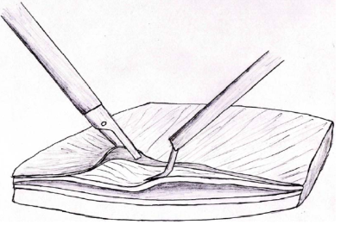
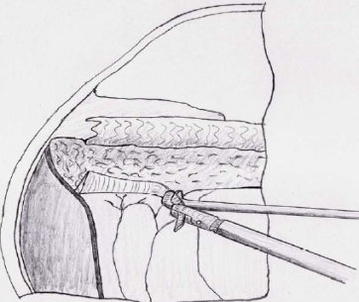
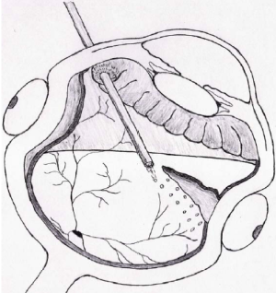
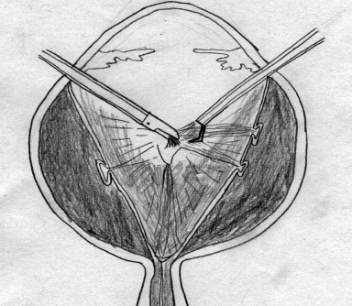
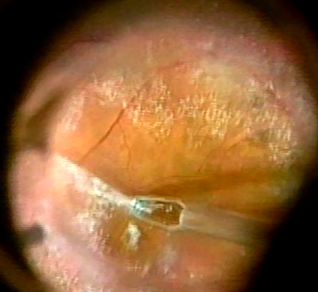
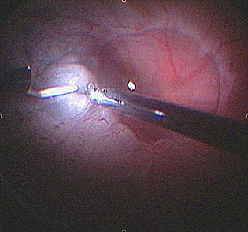
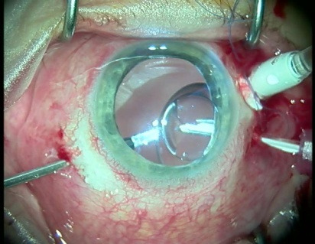
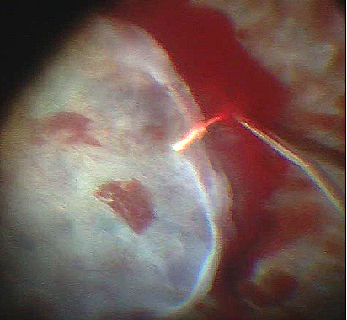
Manipulation Cases for Hollow Suspended organs
Case 1
Case 2
Case 3
Case 4
(A)
3
2
1
3
2
(B)
3
(C)
2
3
(D)
3
1
1
1
1
1
2
1
1
2
2
3
3
3
3
3
2
2
3
1
3
1
1
(E)
2
(F)
(G)
(H)
Knife
Membrane
Grasper
Retina
Knife
Heavy liquid
Grasper
Membrane
Grasper
Tool
(I)
(J)
(K)
(L)
Tool under retina
Membrane
Gripper
Tool 1
Tool 2
Tool 1
Tool 2
Case 1: intraocular dexterity
Case 3: Orbital dexterity without constraints
Case 2: intraocular dexterity with constraints
Case 4: Orbital dexterity with constraints
Wei Wei, Roger E. Goldman, Howard F. Fine, Stanley Chang, Nabil Simaan, “Performance Evaluation for Multi-Arm Manipulation of Hollow Suspended Organs”, IEEE Transactions on Robotics, December issue, 2008

Slide 4
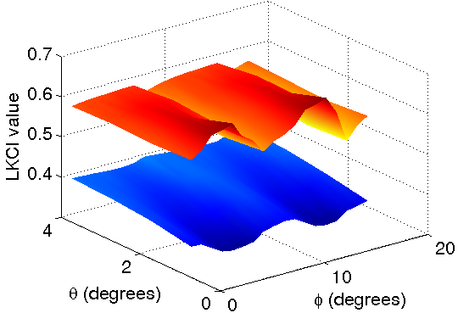
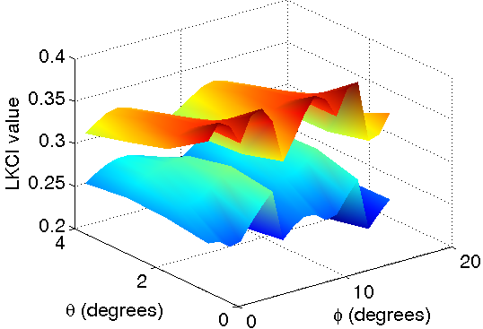
Intraocular Dexterity with/without IODR
Translational intraocular dexterity
Rotational intraocular dexterity
7-DoF without IODR
7-DoF without IODR
8-DoF with IODR
8-DoF with IODR
LKCI = Local Kinematic Conditioning index = average dexterity for a surgical site ±20º around center of site
 | Rotary Cannula (no IODR) | With IODR | Improv-ement
Translational GKCI | 0.2549 | 0.3355 | 31.62%
Rotational GKCI | 0.3660 | 0.5773 | 57.73%
Average intra-ocular GKCI over the whole workspace.

Slide 5
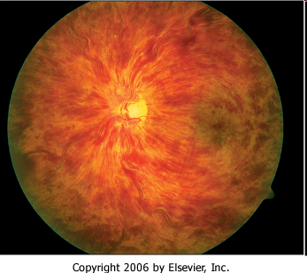
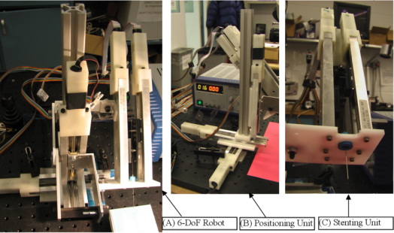
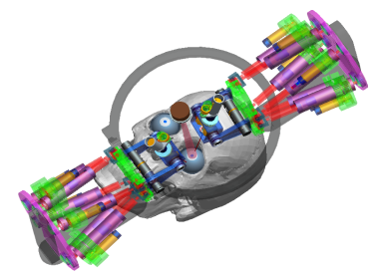
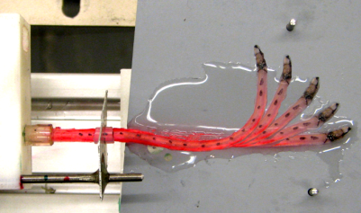
Stenting for treatment of CRVO and BRVO
CRVO
+
=

Slide 6
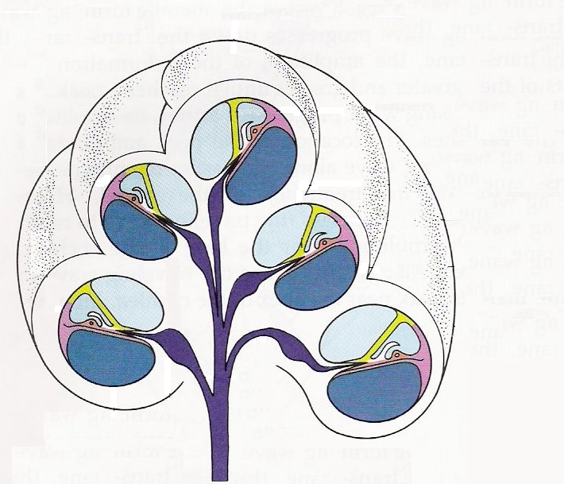
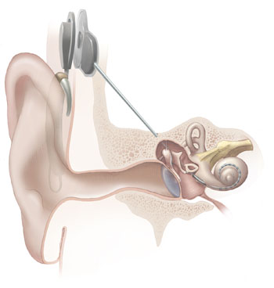
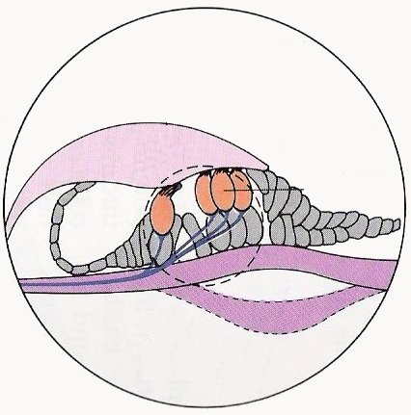
Cochlear Implant Surgery
Apex
Receiver
Cochlear duct
Transmitter
Basilar membrane
Cochlea
Scala tympani
Base of cochlea
Electrode array
Round window
Hair cells
Microphone
& processor
Basilar membrane
Notes:
First of all, let’s take a look at what is CI
CI applies to people with severe hearing loss due to damaged hair cells.
System made up of components including: microphone, transmitter, receiver, round window, electrode
Cross-section of the cochlea, scala tympani, cochlear duct, basilar membrane, base bone of cochlea
Avoid damage basilar membrane, external wall of the cochlea

Slide 7
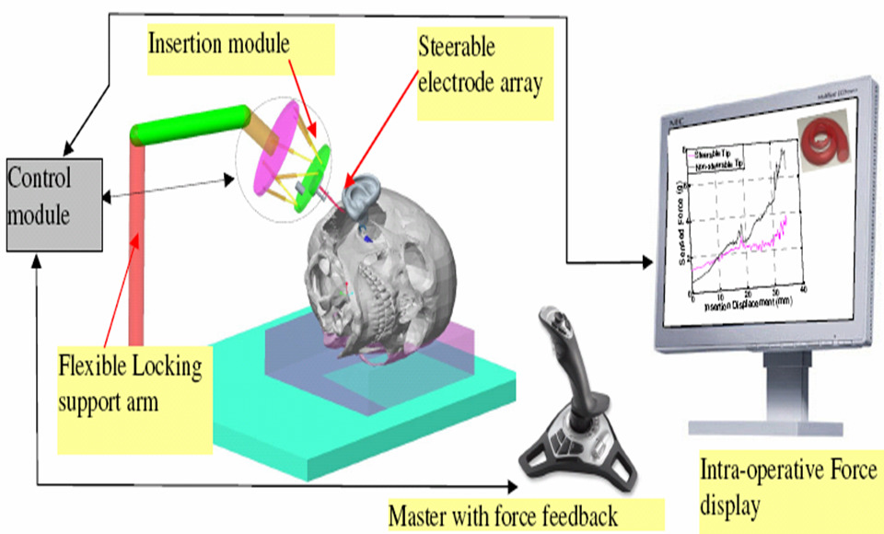
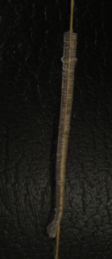
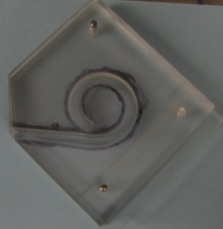
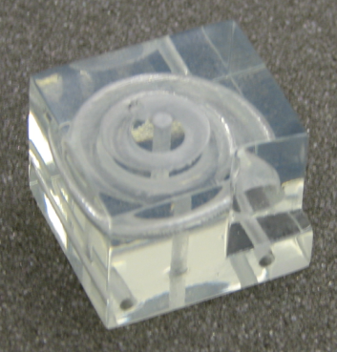
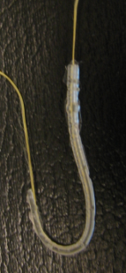
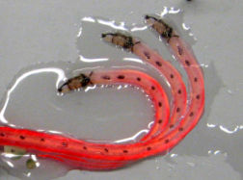
A system for robotic assisted CI surgery
We propose robot-assisted insertion to achieve:
1. controlled insertion force
2. controlled placement of the electrode array
Steerable electrodes
Models of the Cochlea
Actuation thread
Implant (3:1)with
embedded thread
1:1 electrode
2D Cochlea (3:1)
3D Cochlea (3:1)

Slide 8
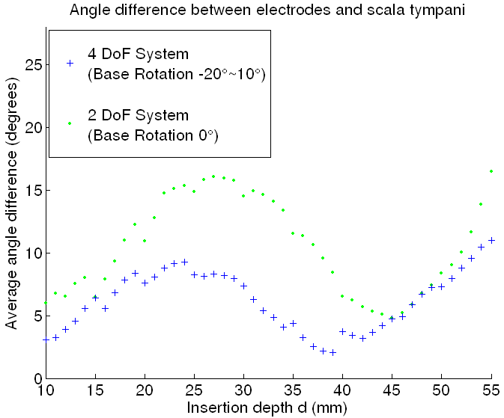
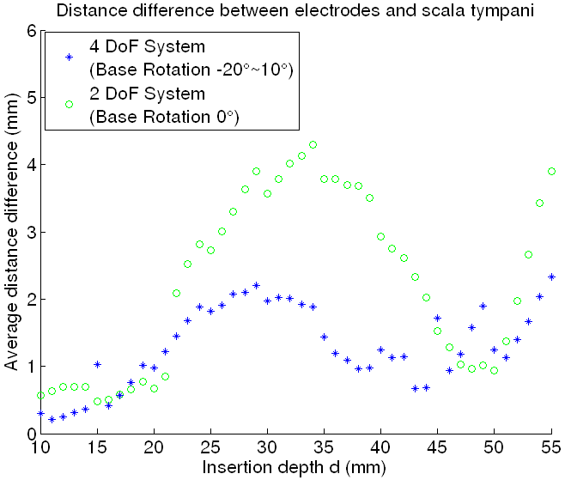
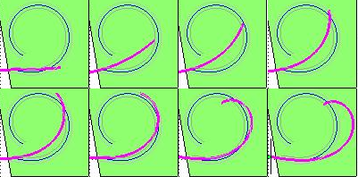
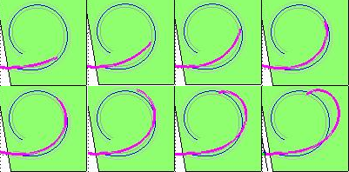
2 DoF Verses 4 DoF System
2 DoF insertion
4 DoF insertion

Slide 9
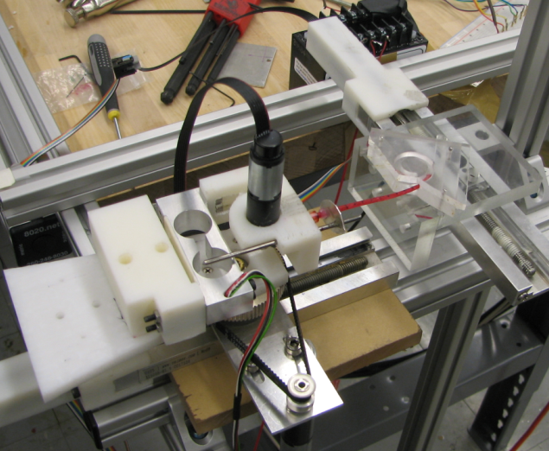
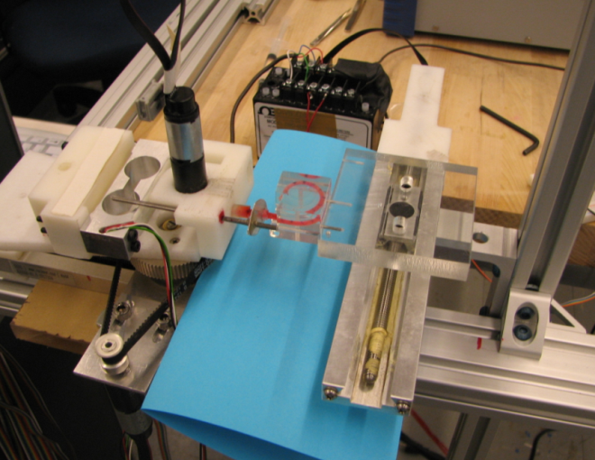
4 DoF System Experiments
q4
q1
q1
q4
2D ST Model
q2
q2
q3
3D ST Model
q3

Slide 10
Safer Cochlear-Implant Surgery
Jian Zhang, Kai Xu, Nabil Simaan, “A Pilot Study of Robot-Assisted Cochlear Implant Surgery Using Steerable Electrode Arrays”, MICCAI’ 2006 best students paper award for clinical application.

Slide 11
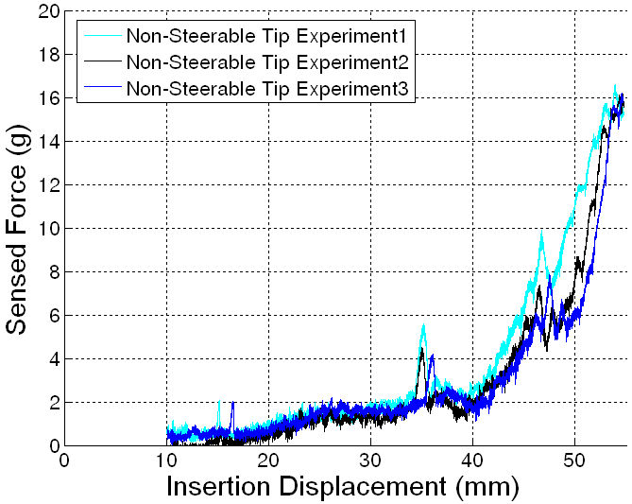
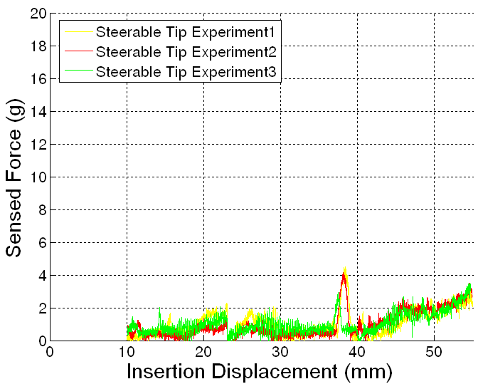
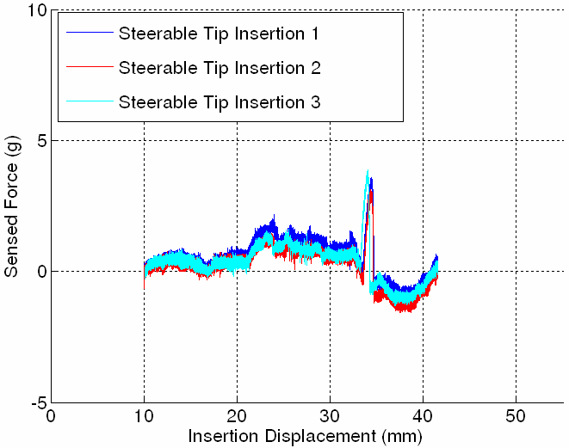
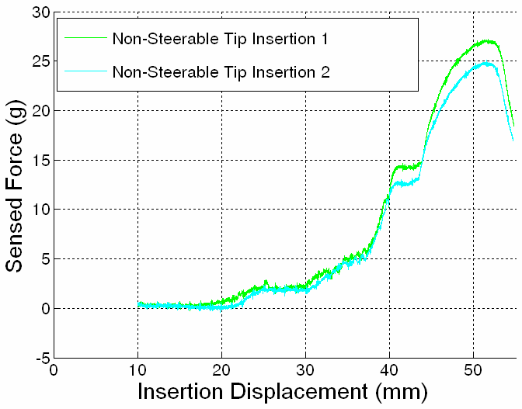
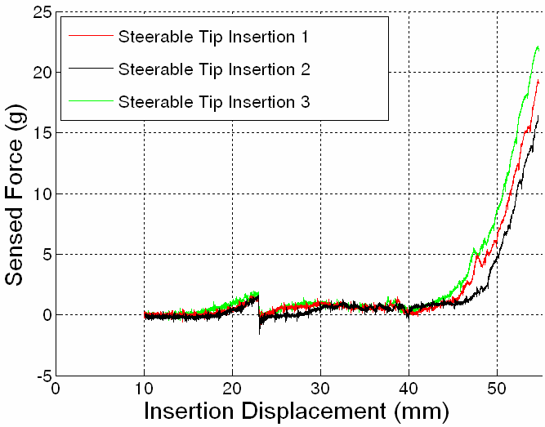
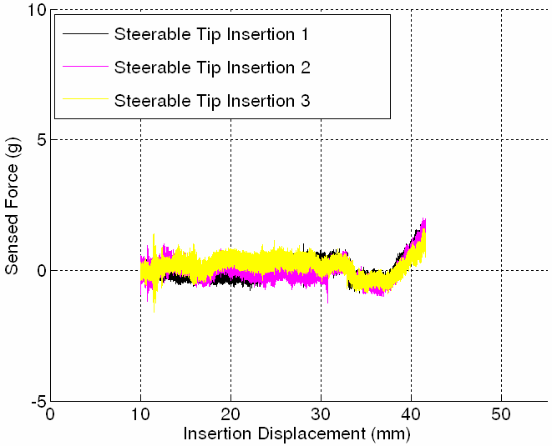
Experimental Results
2D
ST
3D
ST
2DoF Non-Steerable
with force feedback
2DoF Steerable
with force feedback
4DoF Steerable
Zhang, J., Wei, W., Roland, J., Manolidis, S., Simaan, N., “Calibration, Path Planning, and Performance Evaluation for Steerable under-actuated Electrodes for Robot-Assisted Cochlear Implant Surgery”, Submitted to ASME Journal on Medical Devices, 2008.

Slide 12
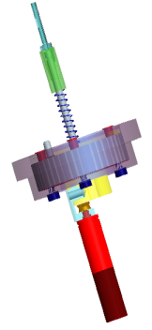
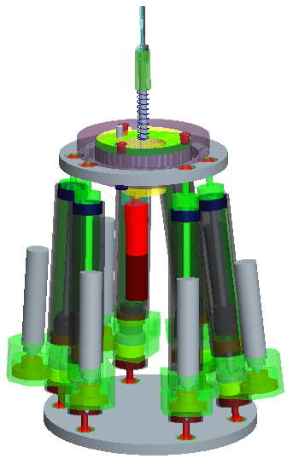
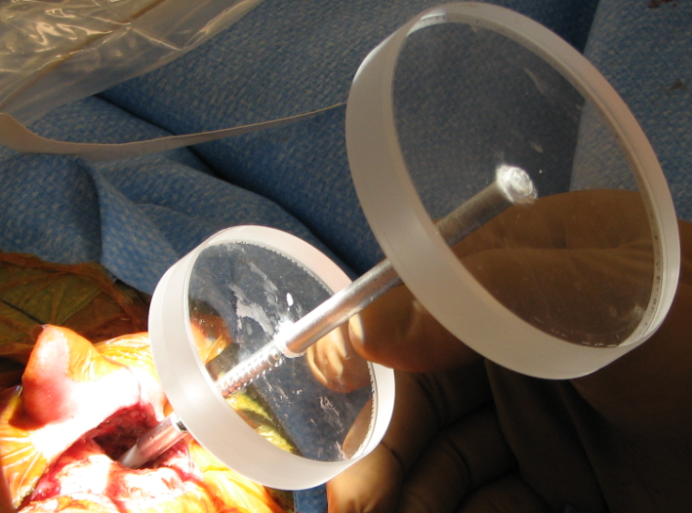
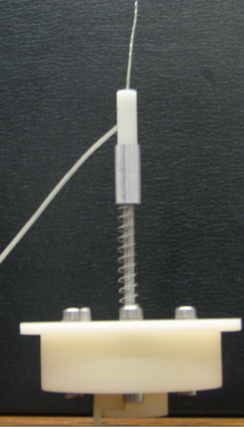
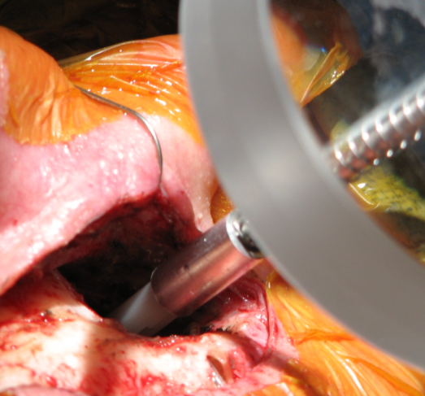
Robotic Insertion Module for Cochlear Implant Surgery
Insertion module
Micro-surgery mode: 500 micron grid

Slide 13
Future Challenges: Reduce cost
Significant reduction in price of robots and procedures can be achieved through the use of dedicated simplified mechanisms
ERC-CISST Steady Hand Robot: $20-30K cost
Low cost RCM mechanism: $5k

Slide 14
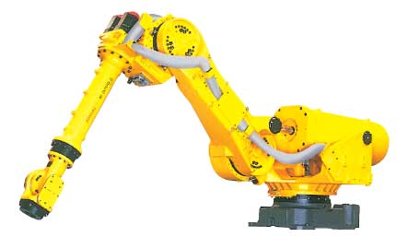
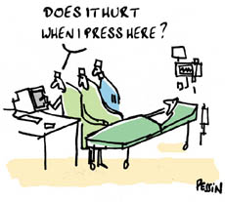
Conclusion
Robot-assisted surgery is still in its early stages
Many applications proved improved success rates when robot are used
The impact of Robot-Assisted surgery in the next 20 years is expected to be as significant as in robot-assisted manufacturing
Robots should be used as tools rather than surgeons
We will still need surgeons – not engineers or programmers ☺
An new generation of engineers & surgeons is needed

Slide 15
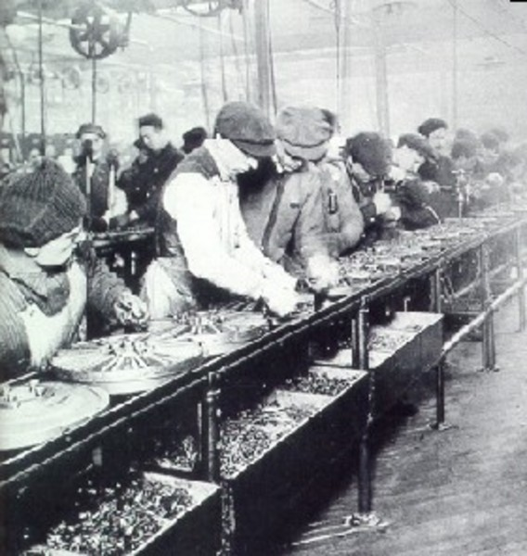
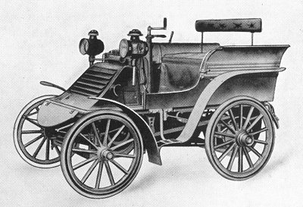
Perspective
Interdisciplinary approach is a must → engineering without bounds
Online sensing of interaction is the key
Need sensory technologies
Need new telemanipulation frameworks for shared awareness and execution of tasks
Need new frameworks for enabling intelligent surgical robots to form understanding of the environment and task during task execution ➔ complementary situational awareness

Slide 16
Robot Assisted TKR
Robotics Lab.
Technion
Robot should be Registered to the bone
D. Glozman Technion

Slide 17
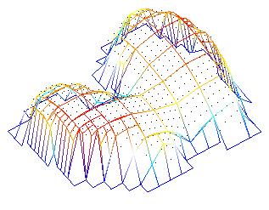
What is registration ?
Linking between preoperative planning and execution phase of CRIS.
Matching all the geometric data available for a patient in a unique coordinate system
Model
Robot
Bone
Tools
D. Glozman Technion
Notes:
CIS 5 : Registration for CIS requires more accuracy than for diagnosis. In addition not only images but also operating systems and tools must be registered. Not only to match images but also to register physical spaces.

Slide 18
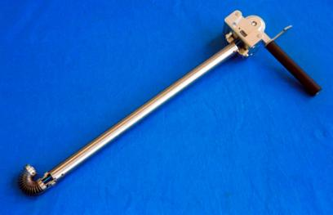
Examples: Dexterity Enhancement
Arthroscopy: 3 mm, SMA, Dario 1997
Wire-based Endo-periscope for MIS, Breedveld P., Hirose S. (2001)
(International Patent pending)

Slide 19
Tools for MIS dexterity enhancement (UC Berkley)
2 DOF Wire-based parallel wrist
Tendon-driven multi fingered hand
Wire-based 2 DOF wrist

Slide 20
Example: Parallel Robot for Ophthalmic Surgery
Micro-Pipette insertion
A parallel robot was used for its high accuracy and compactness
W. Grace (Northwestern University, 1995)

Slide 21
Future Challenges: μ-surgery and Less Invasive Surgery
Requirements:
Manipulate multiple tools through a single Pre-determined port
Provide distal dexterity in confined spaces
Miniaturization
Da-Vinci ® (Intuitive Surgical)

Slide 22
Robotic-Assisted Ophthalmic Surgery
Grace et. al. 1995. Bilateral manipulation, parallel robot, cannulation.
Wei-Tech, Cam Riviere Hand-held device, tremor cancellation, force sensing
Das et. al 1996/NASA JPL Micro-Dexterity Systems
Taylor et. al 1999 Cooperative manipulation. Tremor filtering, virtual fixtures
Mitsuishi 1996 hand-held device with wrist
No intra-ocular dexterity. No manipulation/stabilization of eye under microscope

Slide 23
Surgical task Planning
Orbital Dexterity with Constraint
Orbital Dexterity without Constraint
1
3
2
3
1
1
1
2
Path 1
Start Point
2
3
Path 2
3
3
1
Path 3
Example of path planning for membrane peeling procedure (only half of the eyeball is shown).
LKCI comparison of orbital manipulation with/without constraints

